Slide 1
SWASTHYA
Because health matters…
Internity create-a-thon 2k19
Team : Ignite
Sakshi Gupta( internity intern)
Shivam Grover
Manu S pillai
Rohit kumar
Lovetesh chandra

Slide 2
THEME
HEALTH AND FITNESS
A complete app to cover all three aspects of good health and a fit body
Food
Exercise
Environment
FEE

Slide 3
Key features
Heart rate monitoring system.
Chatbot for health related suggestions.
A virtual doctor chatbot to give solutions (first aid) of common problems
Computer Vision to calculate body fat percentage
A map to show the air quality near you and your surrounding area webview.
Posture Detection

Slide 4
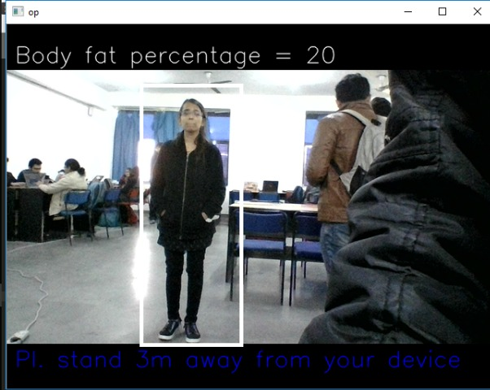
Body Fat Calculator
It uses computer vision and mathematics to calculate body fat

Slide 5
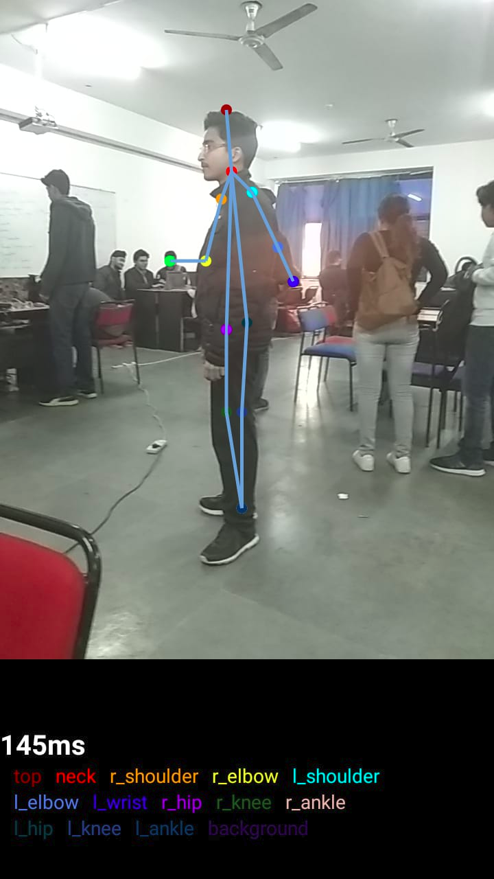
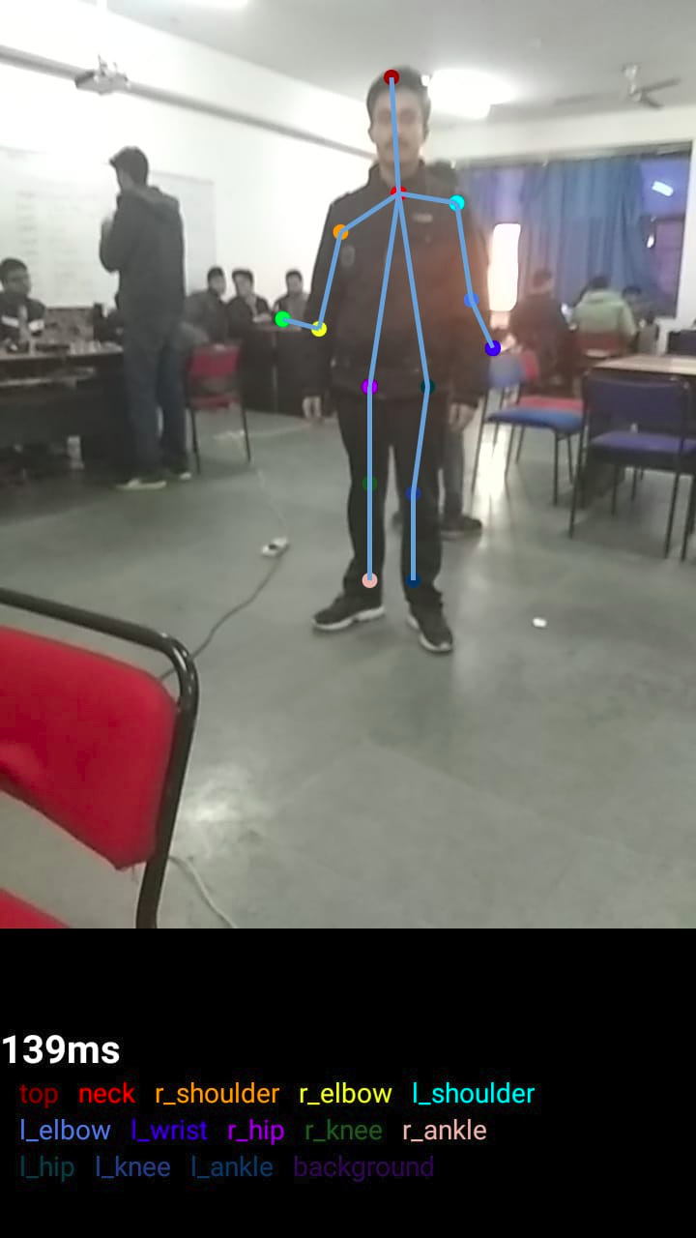
Posture Detection

Slide 6


Heart Rate Monitoring System

Slide 7

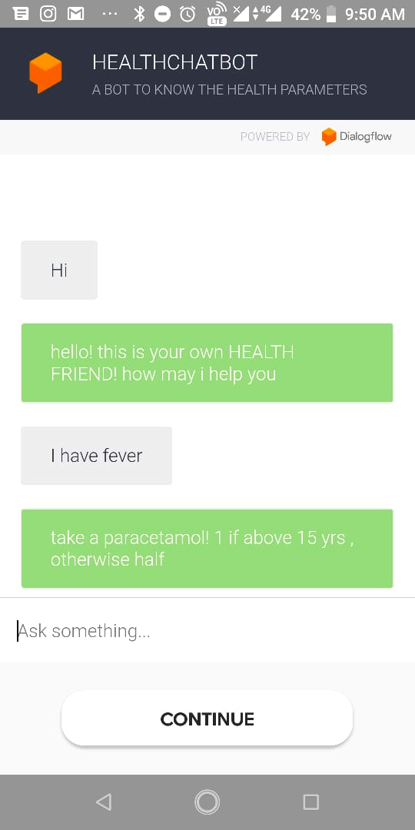
Virtual Doctor
It give solutions (home remedies) of common problems

Slide 8
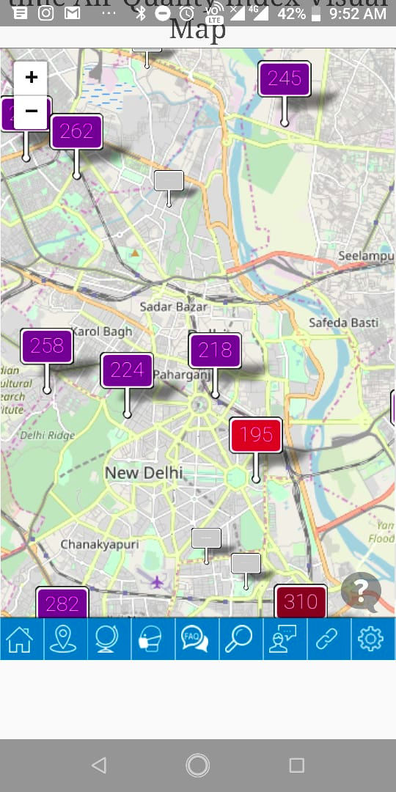
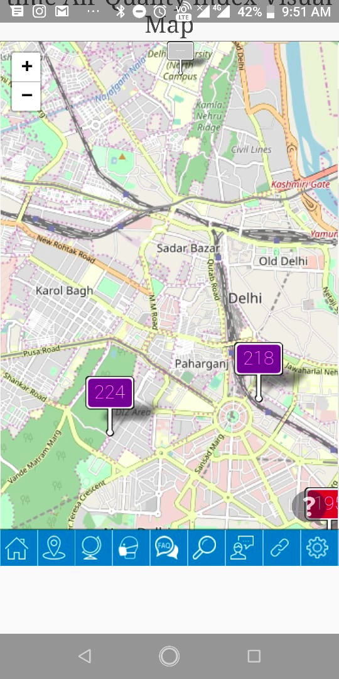
Air Quality Map
A map to show the air quality near you and your surrounding area.

Slide 9
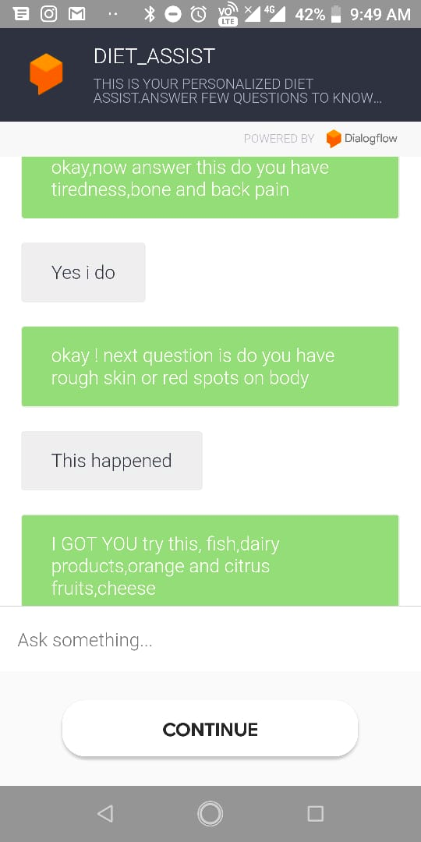
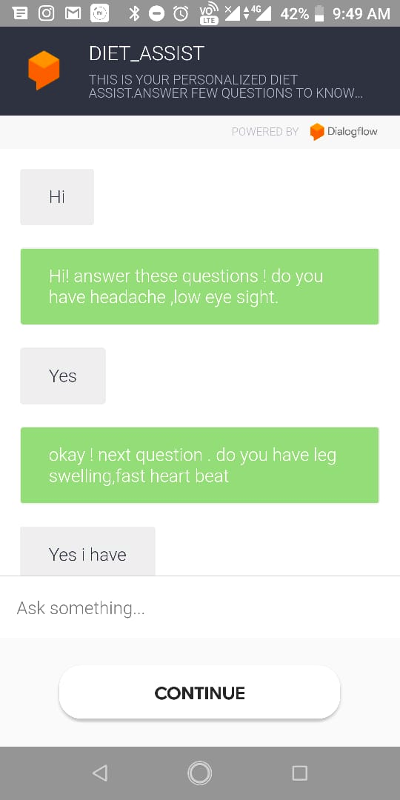
HealthBot
Our own chatbot that suggests corrections in diet as per the health conditions

